Slide 1
an Enterprise Network (Single Site)
DEPI

Slide 2
Project name : an Enterprise Network (Single Site)
Members names :
Mazin Ayman Zahran
Hady Mohammed Eldaly
Mohammed Salah Mohammed
Ahmed Hassan Elsayed
Ahmed Wael Ali
Working with : AST

Slide 3

project IDEA
Build an Enterprise Network (Single Site)
Objective :“Inter Company Connectivity” is a project aimed at enhancing communication and coordination between different departments or levels within the company through an advanced networking infrastructure. The project focuses on connecting various floors or levels, facilitating seamless information and resource exchange, and promoting collaboration and productivity in the workplace.

Slide 4
Week 1
Building Internal Network
Tasks:
Install internal network using Cisco Switches, Routers, Devices, and Servers.
Deliverables:
Design network using Cisco Packet Tracer:
4 Routers
2 L3 SW
3 L2 SW
5 PC
3 Server
4 Print PT
2 Access point
2 laptop
2 tablet

Slide 5
Week 2
Configuration for Access & Distribution Switches
Tasks:
Configure 2 L3 Switches manually.
Configure 3 L2 Switches manually.
Basic Settings for All Devices:
Hostname
Enable secret and VTY password (2024)
Welcome message
Encrypt all passwords
SSH Configuration on Routers and Layer 3 Switches (L3 SW)
VLANs and Port Assignments:
VLAN 10 (Management Room) Fa0/5, Fa0/6
VLAN 20 (Server Room) Fa0/1, Fa0/2, Fa0/3, Fa0/4
VLAN 30 (HR & Logistics) Fa0/1, Fa0/2, Fa0/3
VLAN 40 (Finance &Accounts)Fa0/4, Fa0/5
VLAN 50 (Sales & Marketing)Fa0/1, Fa0/2, Fa0/3
Assign VLANs to respective access ports.
Configure trunk ports between Layer 2 and Layer 3 switches.
Subnetting and IP Addressing:
Create subnets for each VLAN and assign IP addresses.

Slide 6
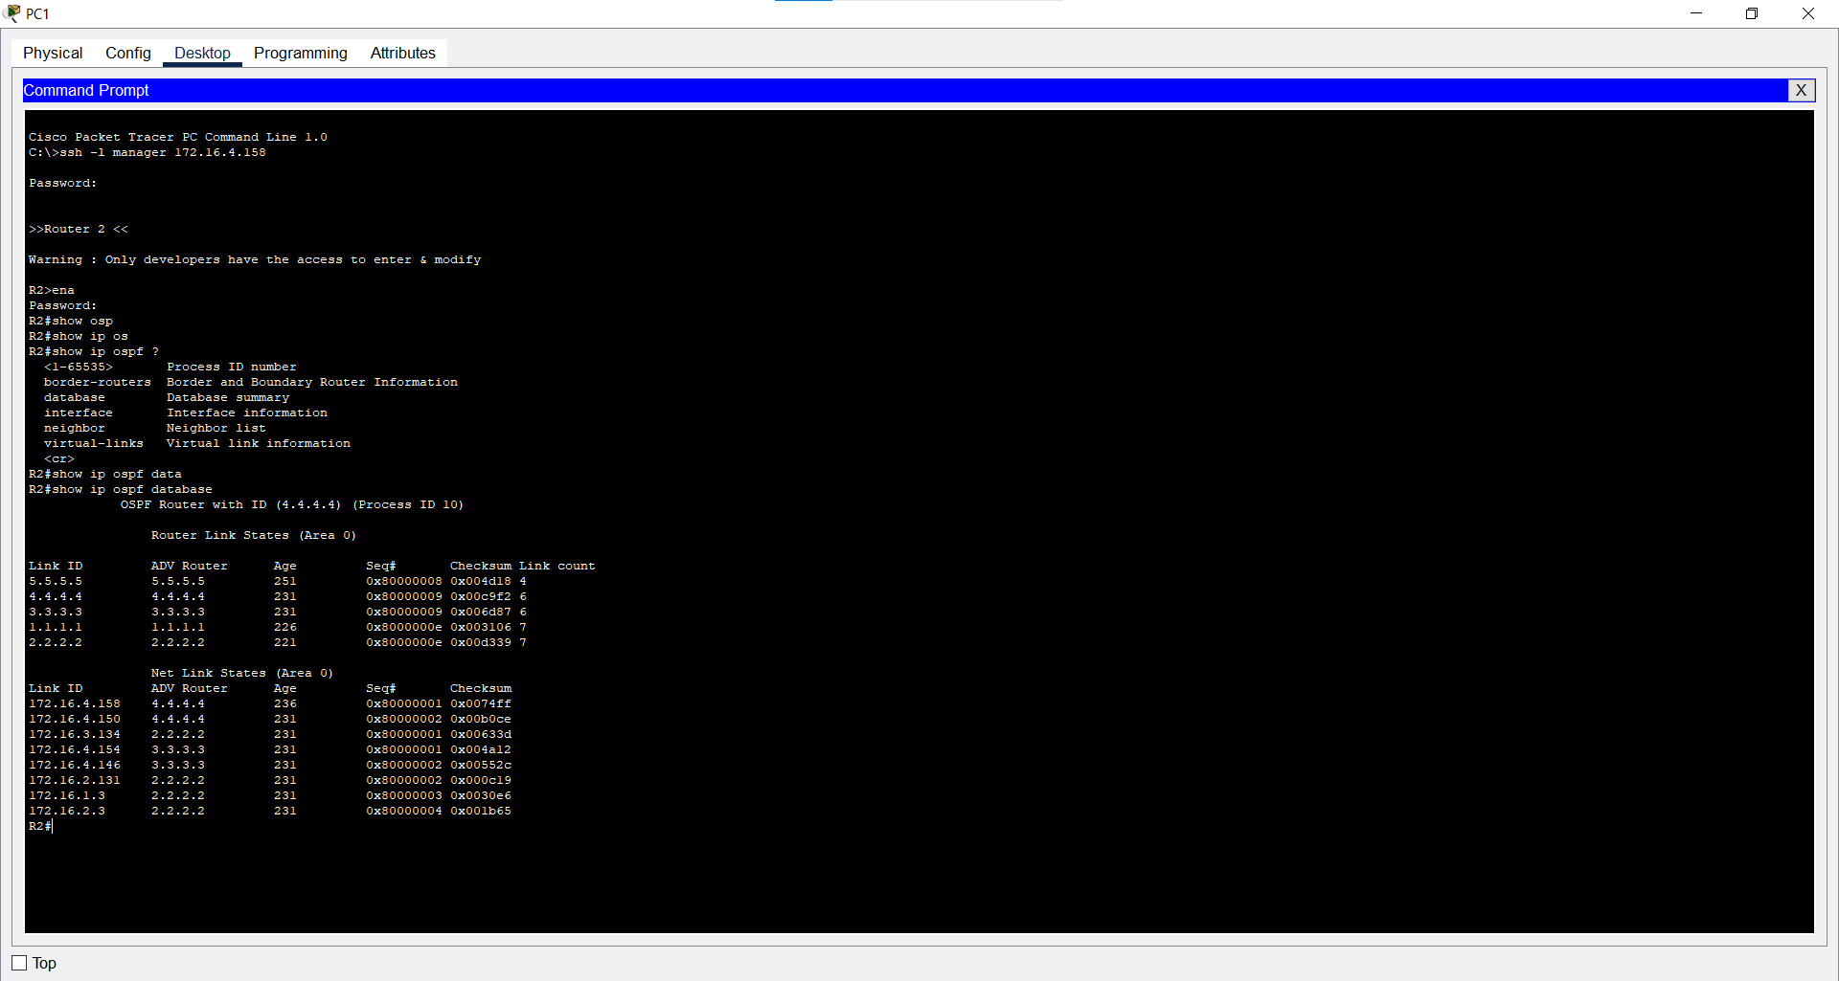
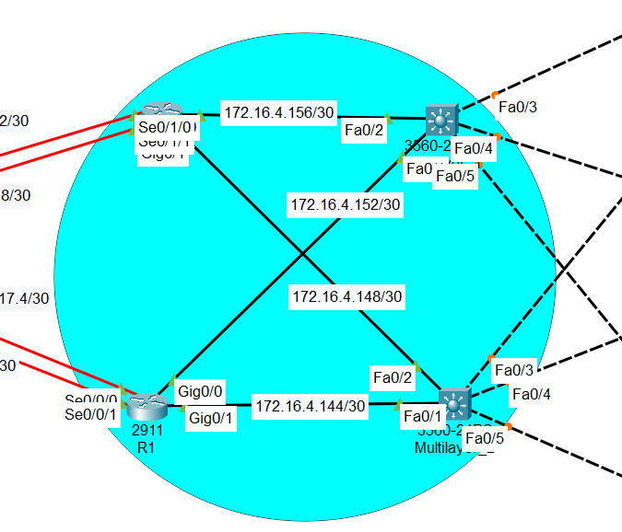
Routing Configuration:
1.OSPF (Open Shortest Path First) : is a dynamic routing protocol that efficiently manages data traffic across the network by determining the shortest path for data packets.
This design improves routing efficiency and scalability by limiting the size of routing tables and minimizing the impact of network changes, ensuring fast and reliable data transfer between both locations.

Slide 7
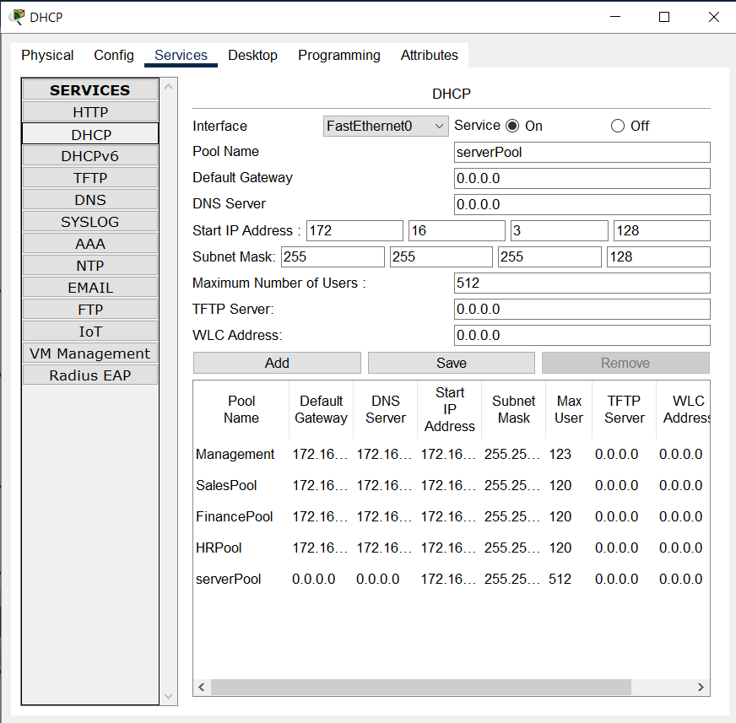
2.Set up Static IP addresses for the Management and Server Rooms (Third floor).​
3.DHCP Server Configuration:
Configure the DHCP server to assign IP addresses to Management Room ,Server Room ,R & Logistics,Finance &Accounts and Sales & Marketing .

Slide 8
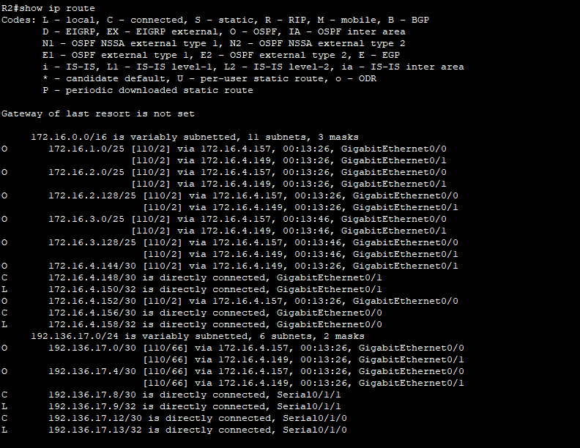
4.Inter-VLAN Routing:
Configure Inter-VLAN routing on the Layer 3 Switch.
Add IP Helper Addresses to forward DHCP requests between VLANs.
Config port security at accesses SW (portsecurity maximum ,violation restrict ,mac-add sticky )
Config acces port as port fast
Protect acces ports from unexpected PBDU
SHRB

Slide 9
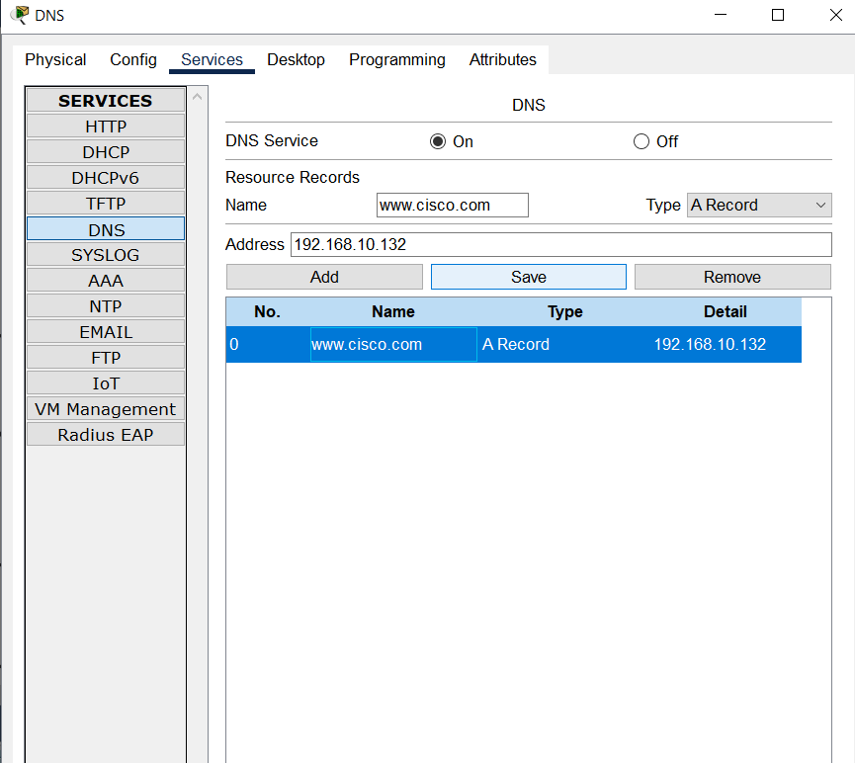
DNS Server Configuration :
The DNS server resolves domain names to IP addresses, simplifying network navigation for users.
This is critical for accessing services without needing to remember complex IP addresses, enhancing user experience and operational efficiency.

Slide 10
Week 3
HSRP protocol
Tasks:
Configure HSRP protocol between multi layer switch and vlans.

Slide 11
Mlt_1:
interface Vlan10
standby 10 ip 172.16.3.1
standby 10 priority 200
standby 10 preempt
!
interface Vlan20
standby 20 ip 172.16.3.129
standby 20 priority 200
standby 20 preempt
!
interface Vlan30
standby 30 ip 172.16.2.129
standby 30 preempt
!
interface Vlan40
standby 40 preempt
standby 0 ip 172.16.2.1
!
interface Vlan50
standby 50 ip 172.16.1.1
standby 50 preempt
!
Mlt_2interface Vlan10
standby 10 ip 172.16.3.1
standby 10 preempt
!
interface Vlan20
standby 20 preempt
!
interface Vlan30
standby 30 ip 172.16.2.129
standby 30 priority 200
standby 30 preempt
!
interface Vlan40
standby 40 preempt
standby 0 ip 172.16.2.1
!
interface Vlan50
standby 50 ip 172.16.1.1
standby 50 priority 200
standby 50 preempt

Slide 12
Week 3
Wireless Network Configuration
Tasks:
Configure wireless access points to provide network access to wireless clients.
Deliverables:
Ensure wireless network settings and security configurations are applied

Slide 13
Week 4
Verifying and Testing Configurations
Tasks:
Verify and test all configurations, ensuring the network functions as expected.
Deliverables:
Test connectivity between VLANs.
Validate OSPF routes and ensure redundancy.
Test wireless network performance.
Ensure management and server rooms have appropriate static Ips
Ensure HSRP is working correctly

Slide 14
